Slide 1
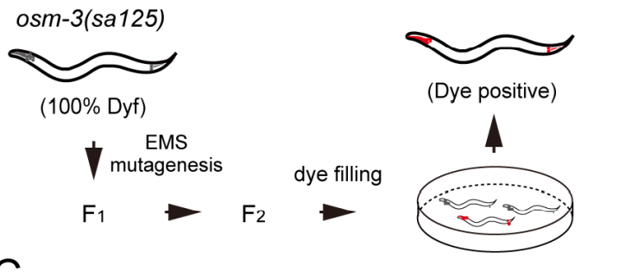
Osm-3 p802
G444E
Mapping
Whole Genome Sequencing
Phenotype II
dye-filling
Phenotype I
Compare with wildtype
And Mapping samples
~300 Single nucleotide variation due to EMS
Can focus on about ¼ length of a Chromosome

Slide 2
Screening
Screening
50-100 Samples
5-6 Samples
Sequencing
Mapping
1 month
Analyze
Sequencing
Next-gen seq is becoming cheaper
Can get a lot of allele and gene once a screen
Mapping free
Accurate and save a lot of money

Slide 3
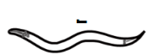
Step 1: Creat a SNP pool with SNPs have impact on amino acid
Tag
Impact SNP pool
Of Sup 1
Suppressor mutant 1
taglist
NEKL-4 SNP
SNP of all
……

Slide 4
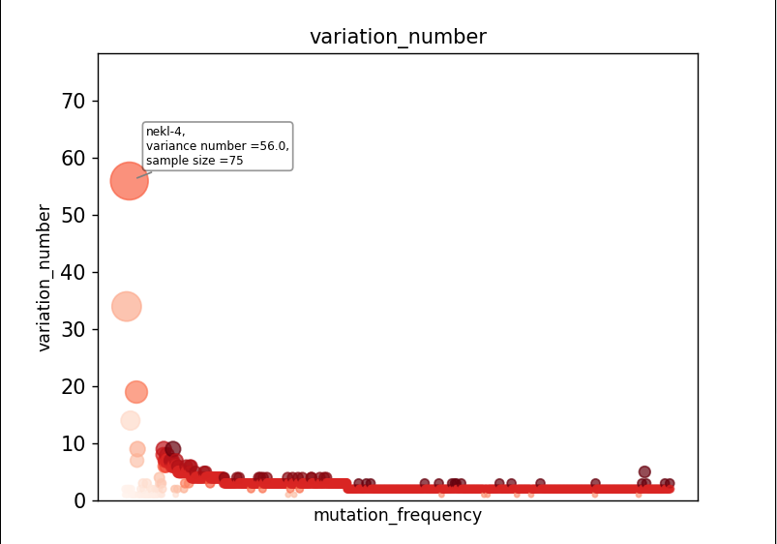
Sample size = 95

Slide 5
Step 2: Remove low possibility SNPs
Gene
Gene
Gene
1.If Nekl-4 is a suppressor
You can hardly find another suppressor
Gene In nekl-4 SNP pool
Gene
SNP Pool
Of All Input
SNP Pool
2.Because that almost all the SNPs in
SNP pool have an impact on protein
structure and amino acid. Genes linked
to the SNPs in the suppressor pool
can be considered as ‘not likely’ as well
Gene
Of Nekl-4 mutant
Gene
(intersection factor = 3%)
Problem: Impact SNP cannot be decided easily so there
might be a lot of false-negative cases

Slide 6
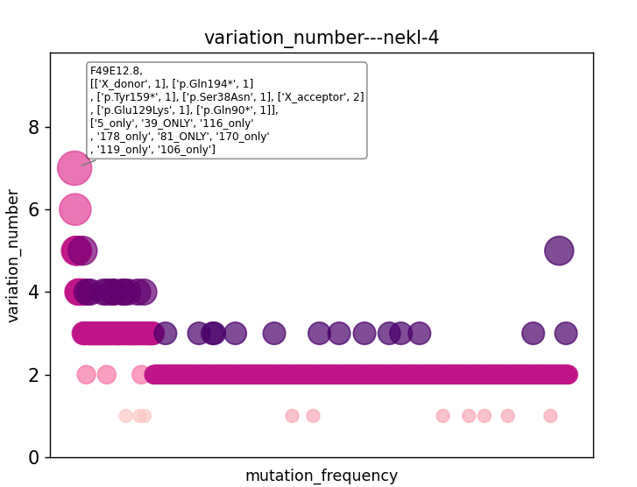

Slide 7
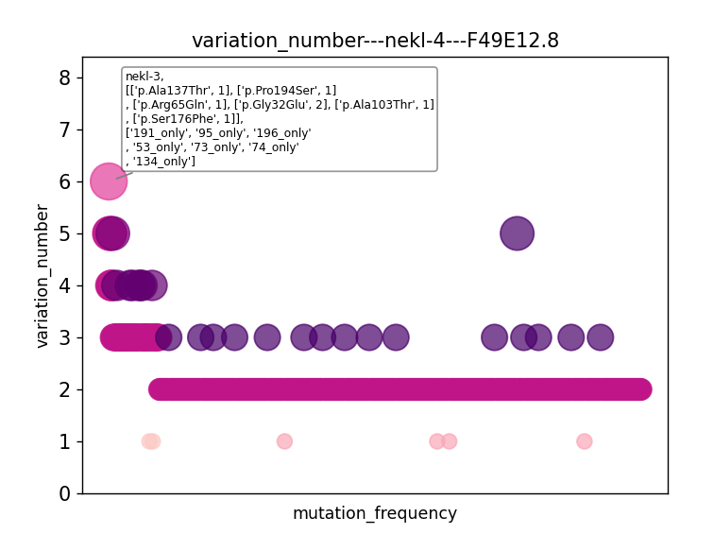

Slide 8
Using statistical model to distinguish genes
(Why suppressors can exclude each other)
Gene A= 75
Gene B = 7
If genes are randomly distributed:
c
n
95-n
P(A+,B+)=
n
P(++)
(1-P(++))
95
When suppressor screening:
1
2
3
4
5
6
.
.
.
95
+
+
+
+
+
+
+
H0 : B is not a suppressor
P = P(A+,B+)*P(no-sup)
P(no-sup)=n(no sup SNP)/(n(all SNP)-n(A SNP))
What about the P adjustment when multiple comparison?

Slide 9
To explain the reason that nekl-4 share a suppressor mutant with nekl-3
1. P(no-sup) = (9703-95)/(9703-75)
c
n
95-n
2. P(nekl-4+,nekl-3+) =
n
P(++)
(1-P(++))
95
3.P(++) = (7/95)*(75/95) = 0.0582
When one of them is no-suppressor mutation:
c
n
95-n
2. P(nekl-4+,nekl-3+) =
n
* 0.0582
* 0.9418
* P(no-sup)
95

Slide 10
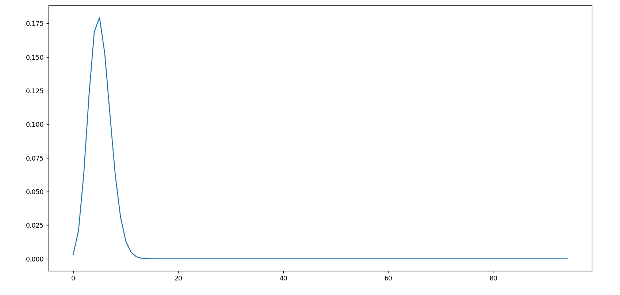
Both them are no-suppressor mutations: nekl-4(75) vs nekl-3(7)
c
n
*P(no sup)
95-n
n
P(nekl-4+,nekl-3+) =
* 0.0582
* 0.9418
95
P < 0.05: x<2.04 or x > 8.4

Slide 11
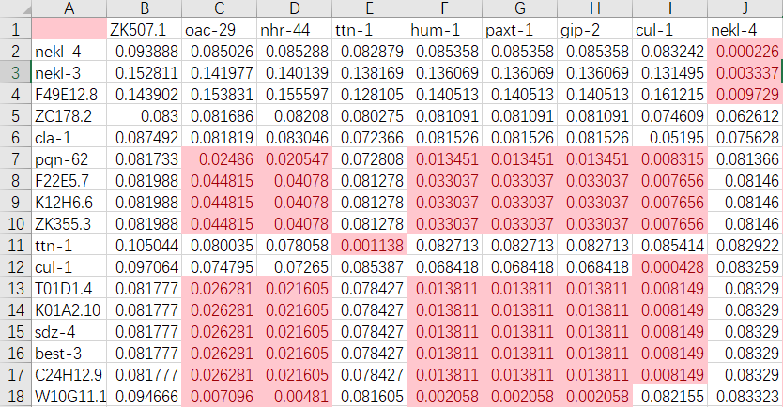
Gene to gene p value
P<0.05: n<a suppressor n>b enhancer?

Slide 12
SNP pool of
osm-3(sa125) suppressors
Unc-89
Nekl-4
ttn-1
Gene x

Slide 13
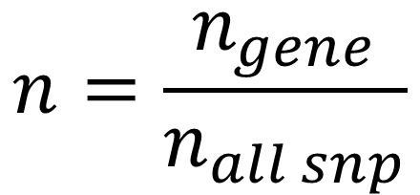
Toy data：Che-3, osm-3, unc-89, let-418
gene
Sample size
SNP number
Gene a
Gene b
Gene c
Gene d
95
98
43
175
95000
98000
43000
175000
26
5
5
3
6
2
1
1
33
32
16
45
1 (+1)
0 (+1)
0 (+1)
1 (+1)
Che-3
osm-3
unc-89
let-418
1. normalization
$$n=\frac{n_{gene}}{n_{all snp}}$$

Slide 14
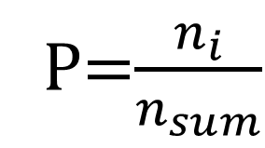
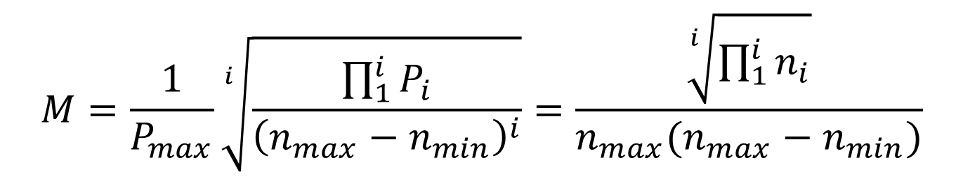
Get the M score of a gene in different screenings
$$M=\frac{1}{P_{max}}\sqrt[i]{\frac{\prod_{1}^{i}{P_{i}}}{{\left(n_{max}−n_{min}\right)}^{i}}}=\frac{\sqrt[i]{\prod_{1}^{i}{n_{i}}}}{n_{max}(n_{max}−n_{min})}$$
P=$\frac{n_{i}}{n_{sum}}$
gene
Sample size
Gene a
Gene b
SNP number
Gene c
Gene d
95
98
43
175
95000
98000
43000
175000
0.391
-
-
-
2.129
-
-
-
7.552
-
-
-
-
-
23.5
-
Che-3
osm-3
unc-89
let-418
Conclusion:
Gene a and Gene b might be the candidate of che-3 screening, Gene c and Gene d is a trash

Slide 15
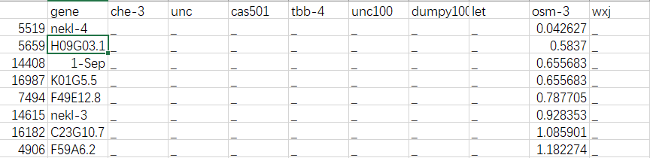
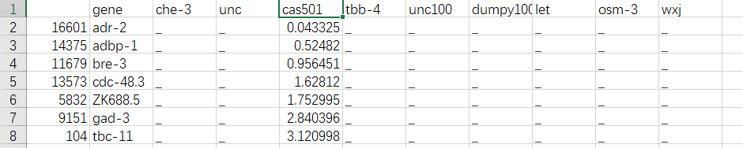
Osm-3 G444E
Dyf-5 T164E

Slide 16
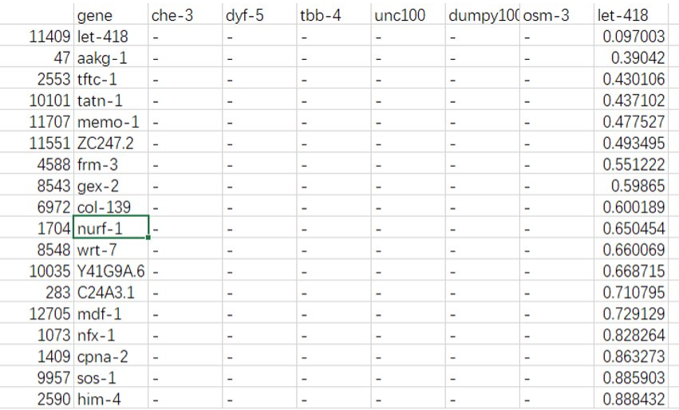
Let-418

Slide 17
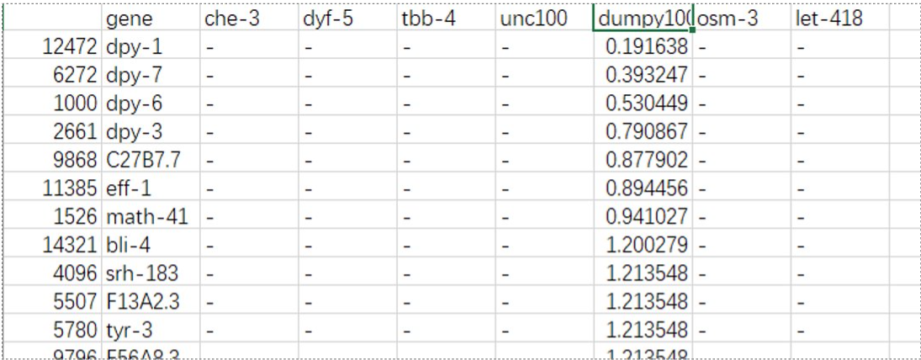
dumpy

Slide 18
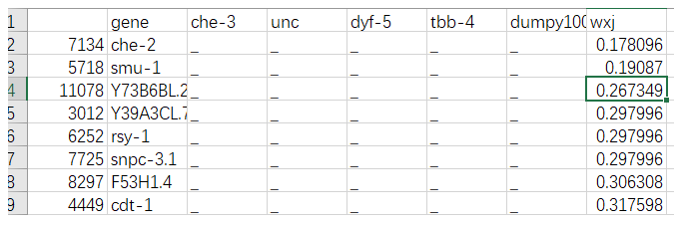

Slide 19
Unsolved problems：
Unexpected noise？
Alignmentみたいな点数システムを作りたい

Slide 20
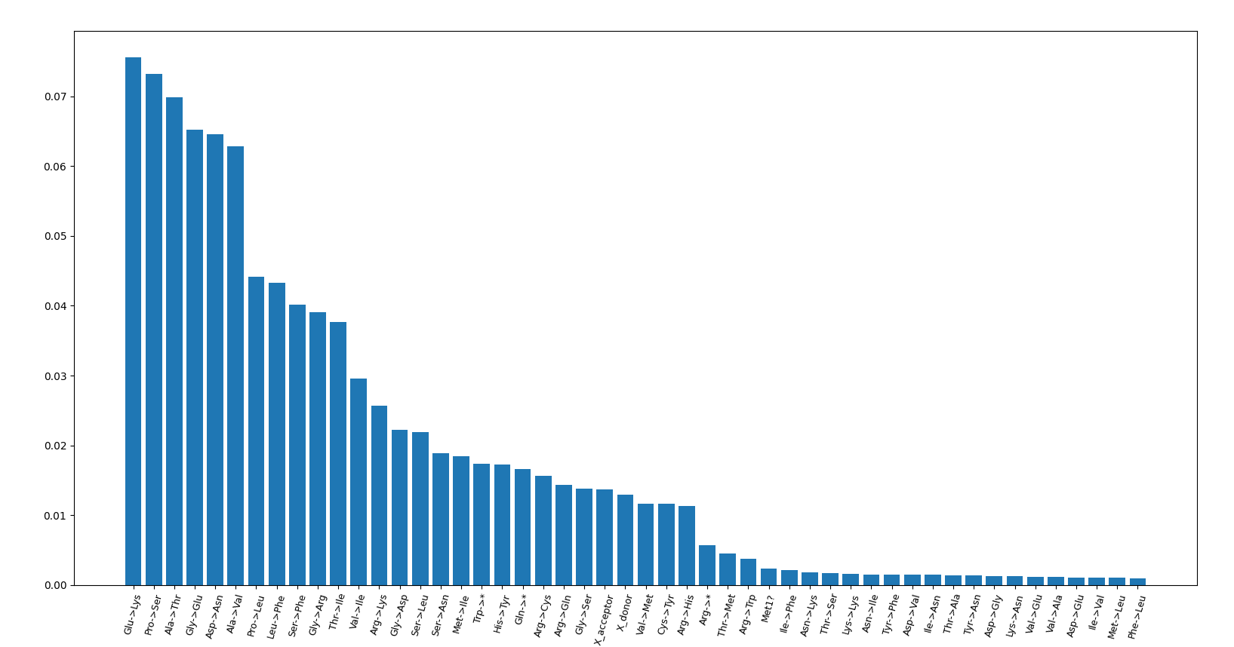
TBB-4(sa127)

Slide 21
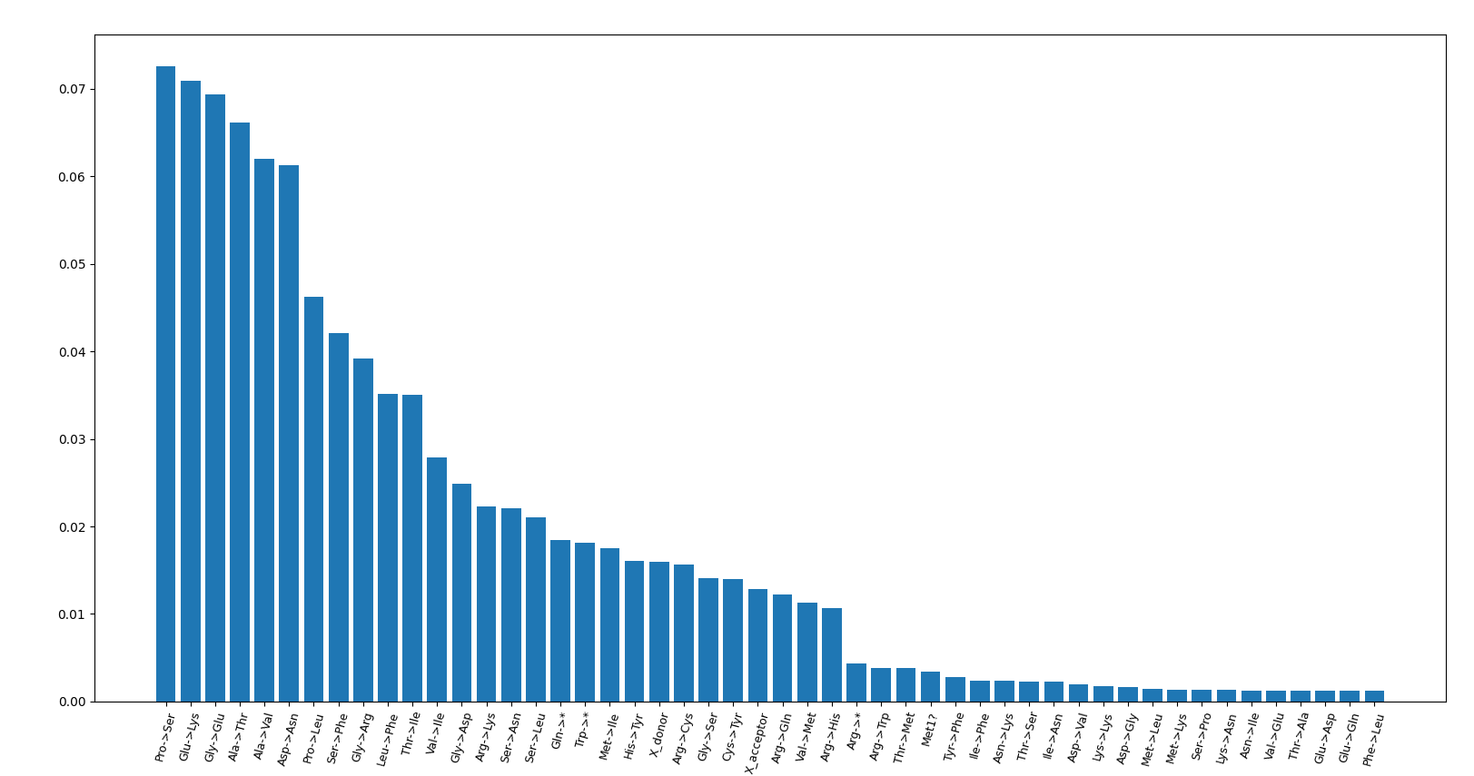
dumpy

Slide 22
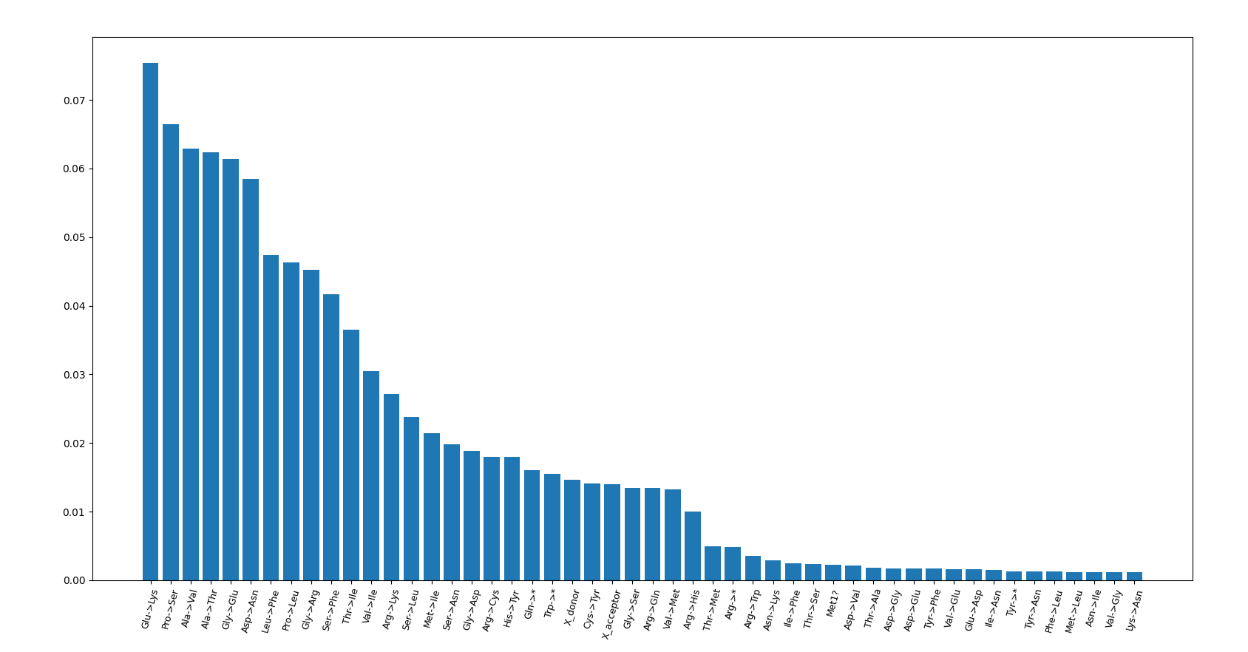
Dyf-5(cas501)

Slide 23
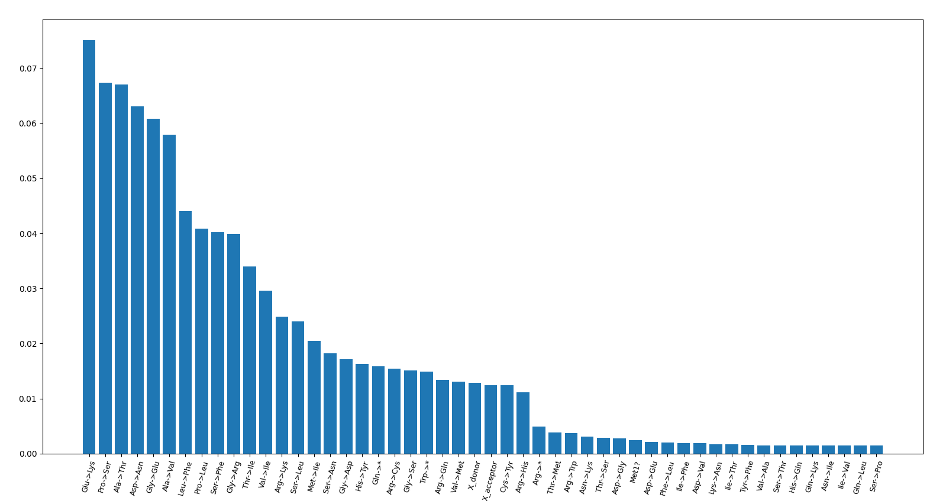
Che-3

Slide 24
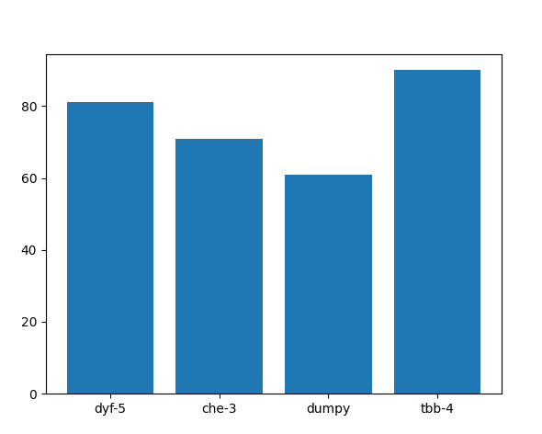
Impact mutation per sample

Slide 25
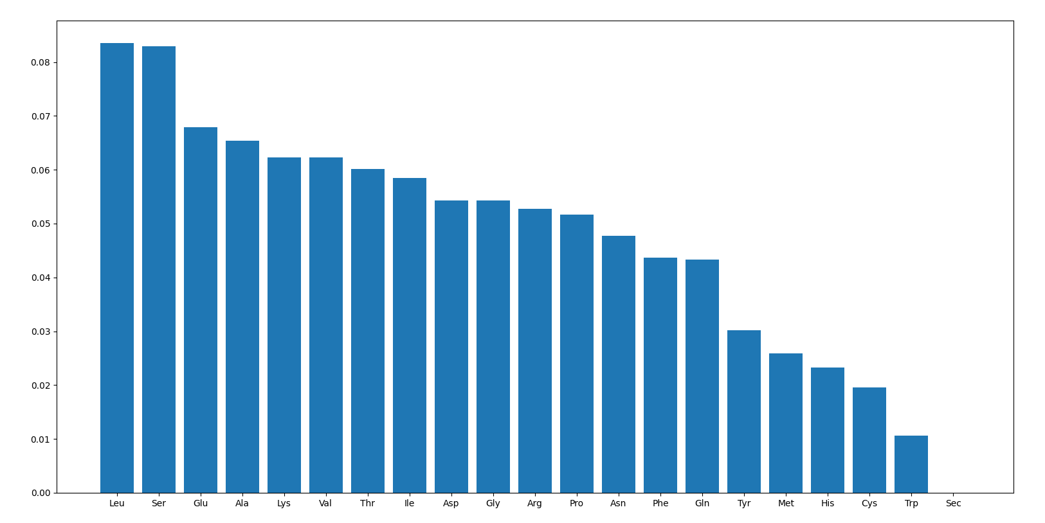
Amino acid frequency

Slide 26
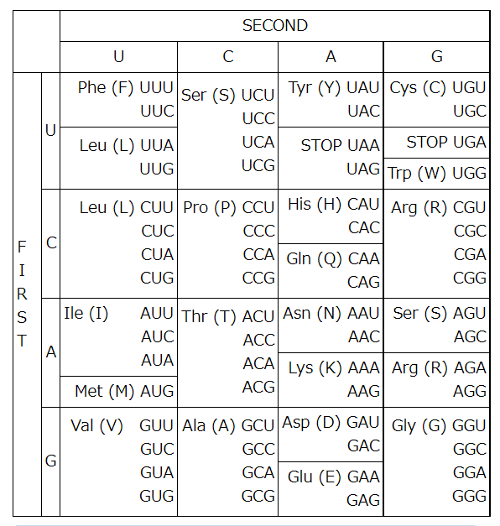
C>U or G>A

Slide 27
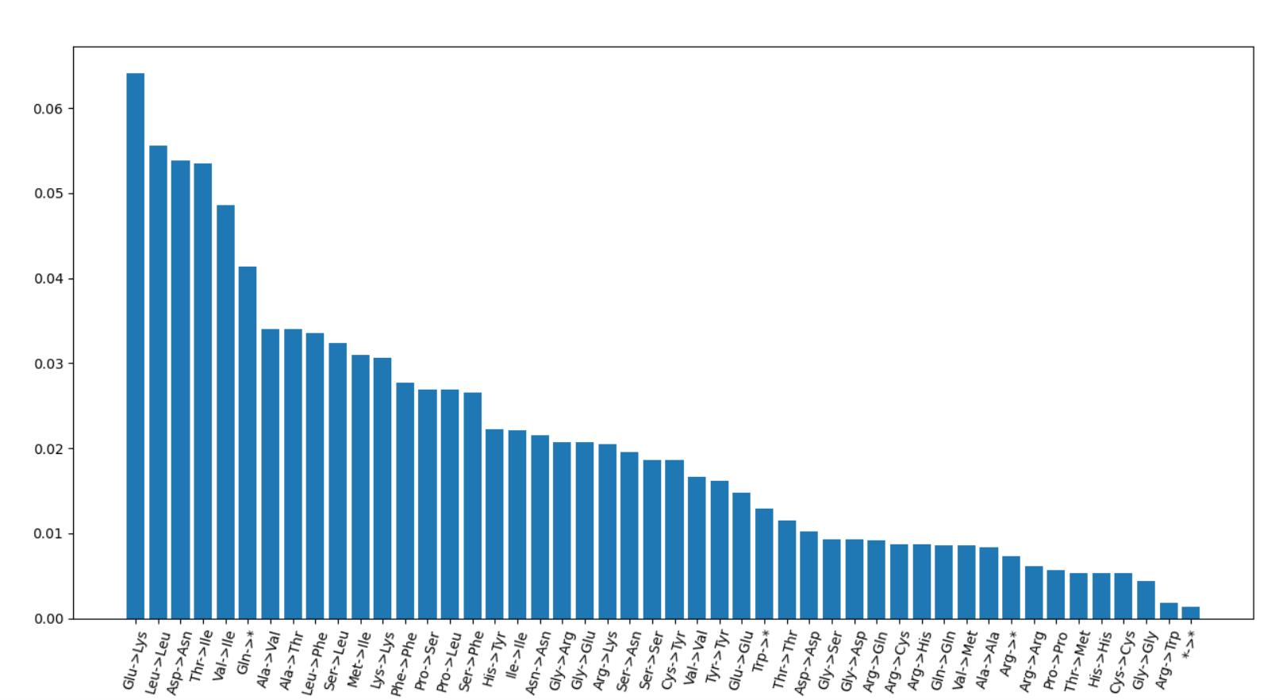
Take codon usage, amino acid count, and EMS-induced codon change into consideration
1
5
6
2
3
4

Slide 28
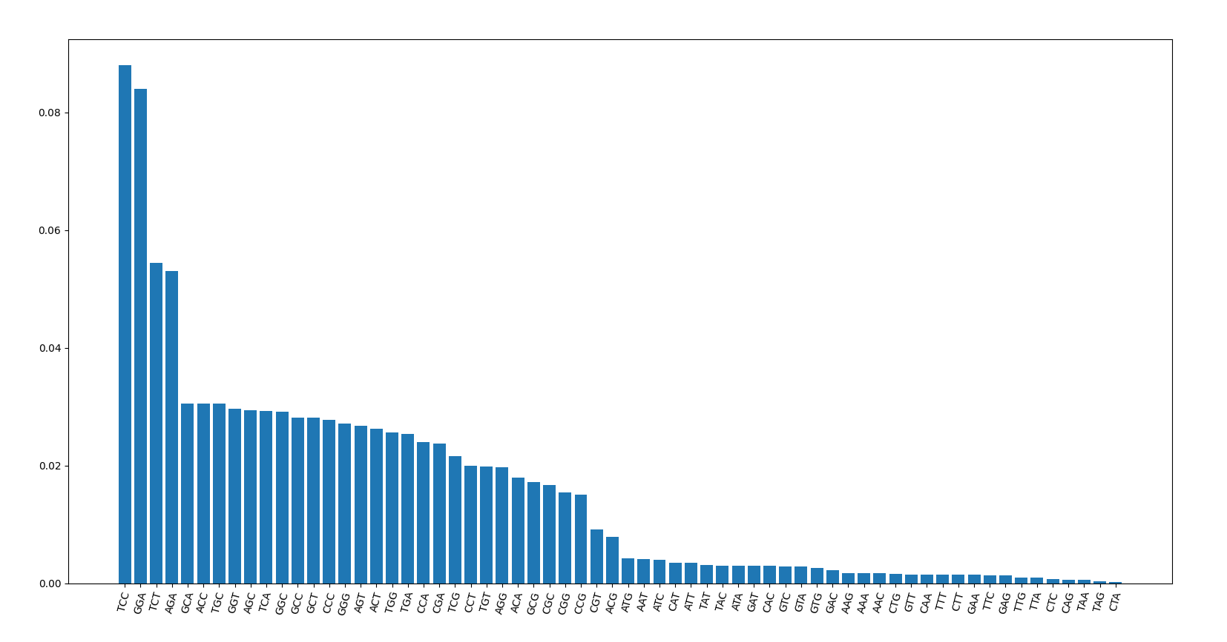
Neighbor base-pairs?
dumpy

Slide 29
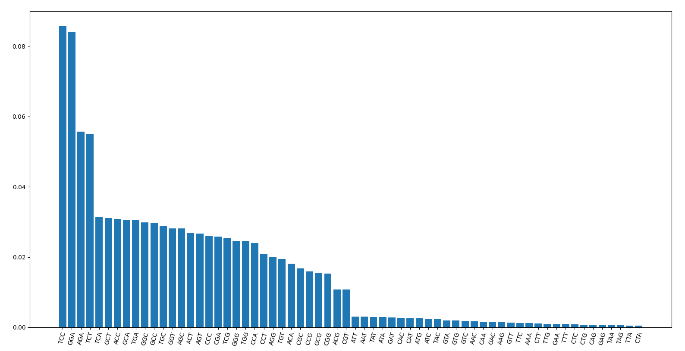
Tbb-4

Slide 30
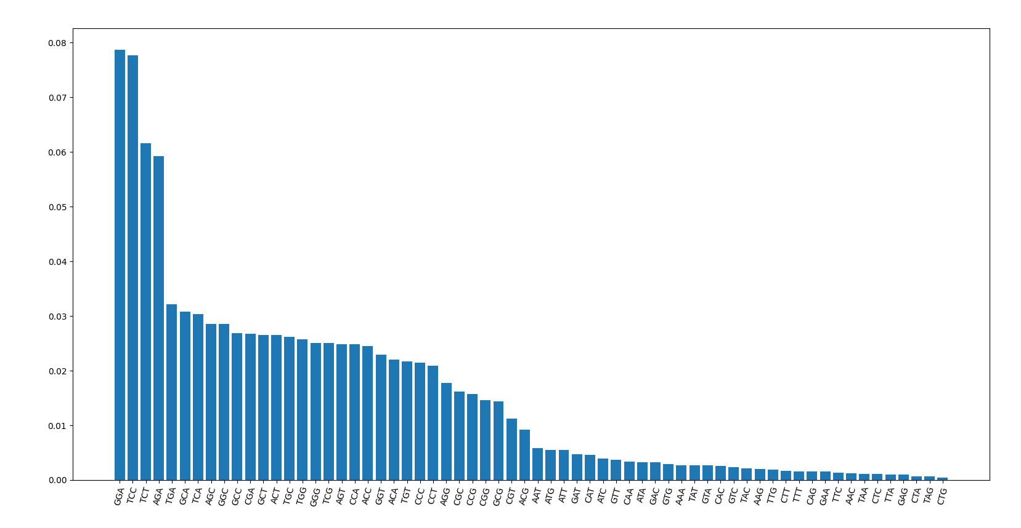
Che-3

Slide 31

Dyf-5

Slide 32
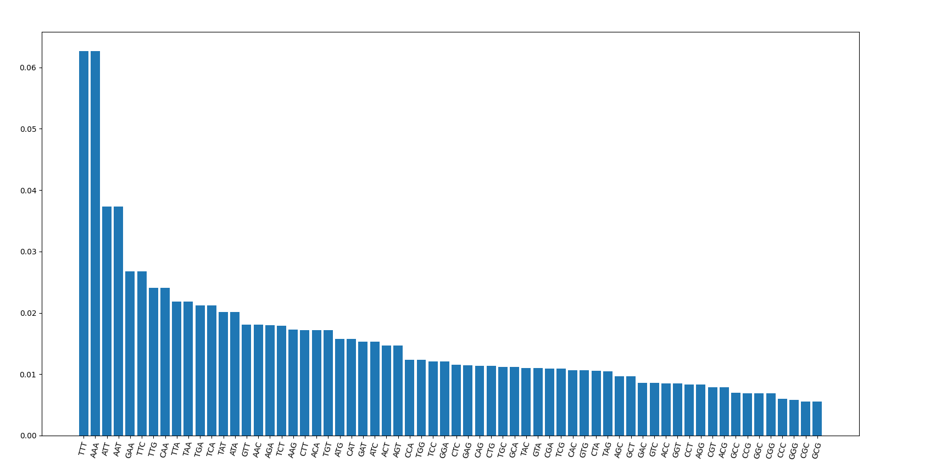
Neighbor combination of C elegans genome
TCT
AGA
TCC
GGA

Slide 33
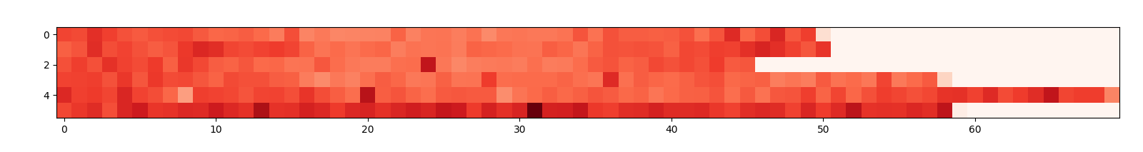
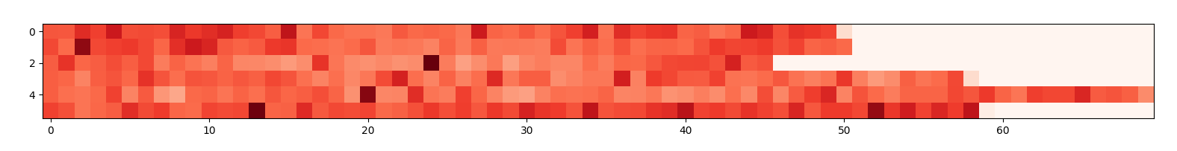
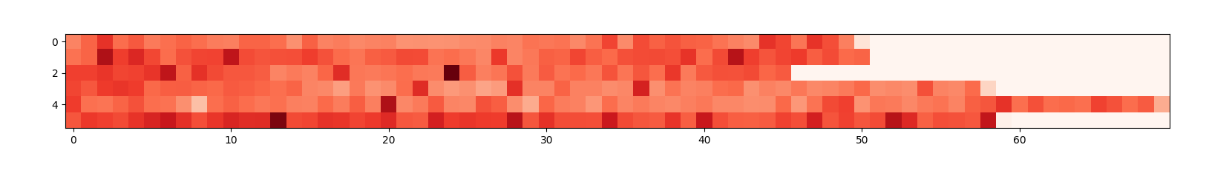
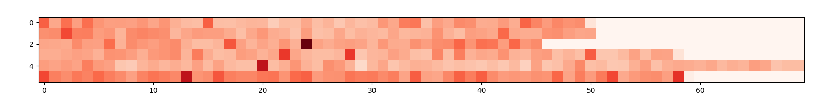
Mutation frequency per 300000 base
tbb-4 (438)
tba-5 (195)
dumpy (256)
unc (120)

Slide 34
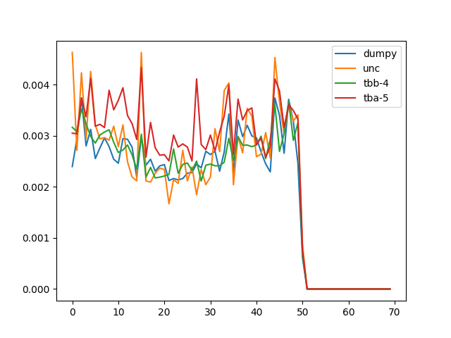
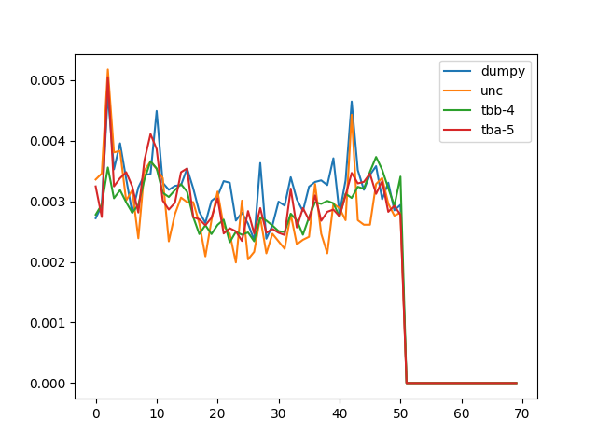
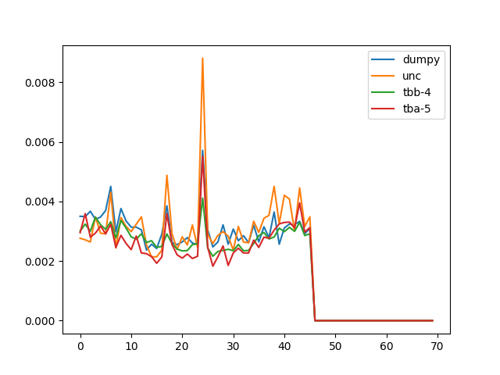
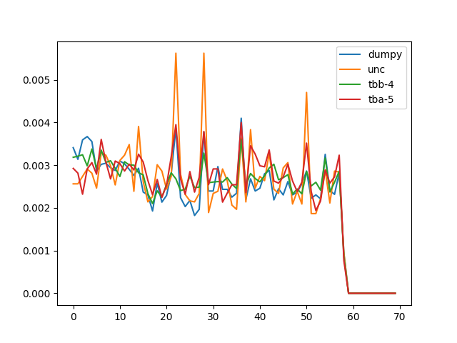
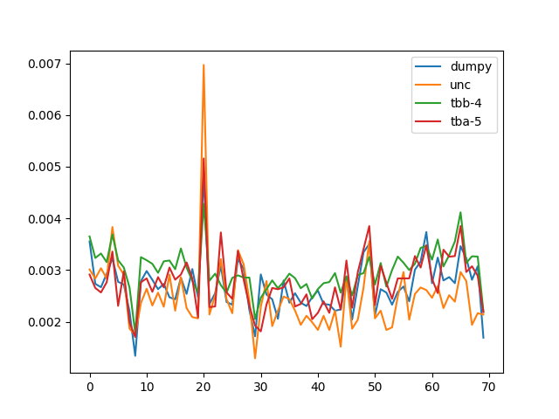
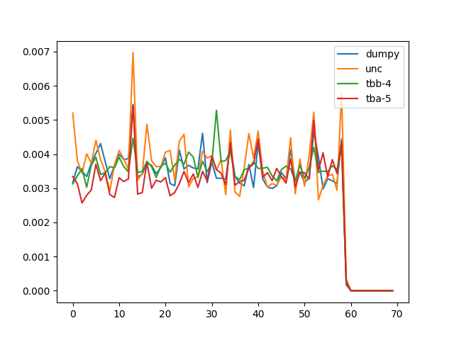
Mutation frequency per 300000 base
I
II
III
IV
V
X

Slide 35
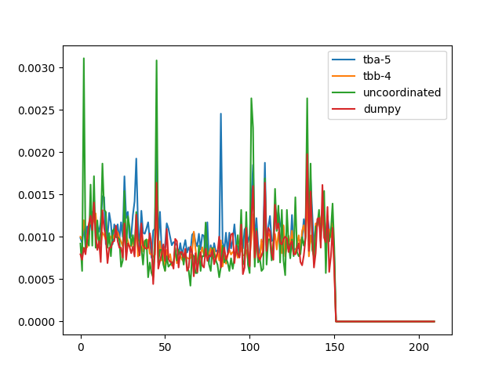
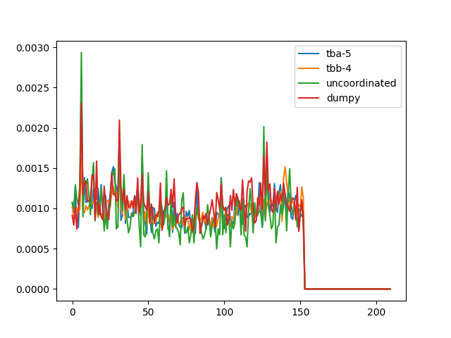
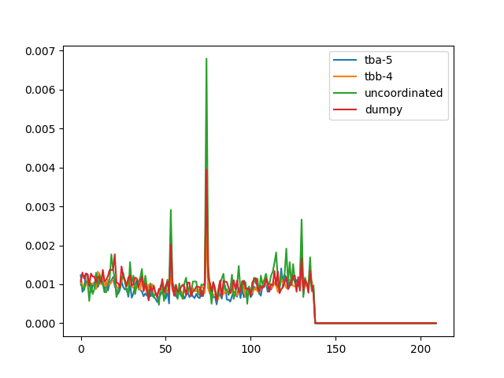
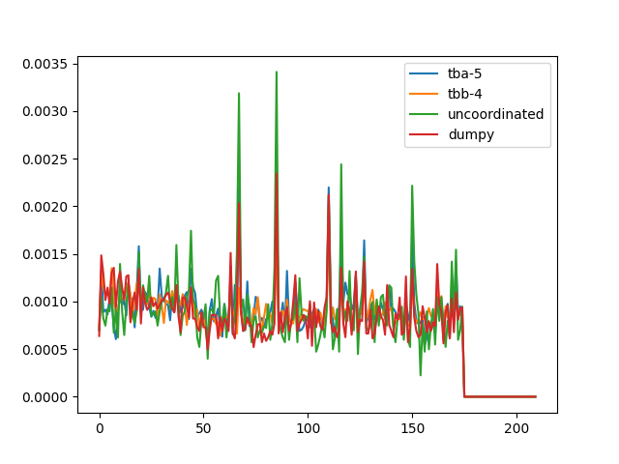
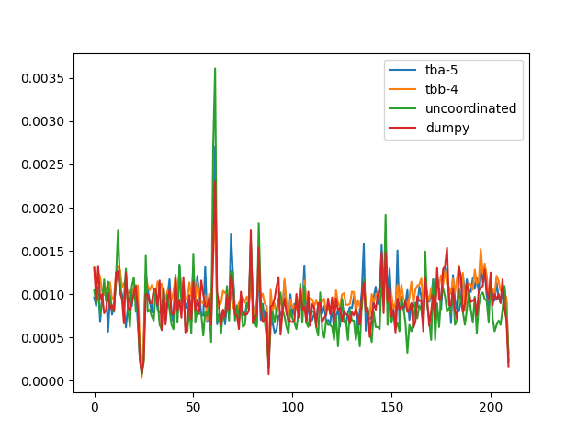
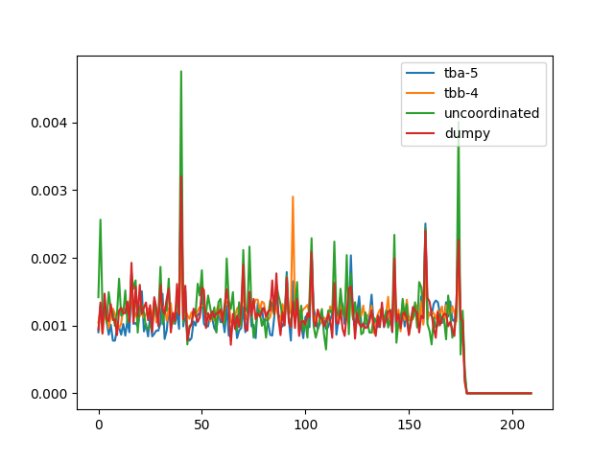
I
II
III
IV
V
X

Slide 36
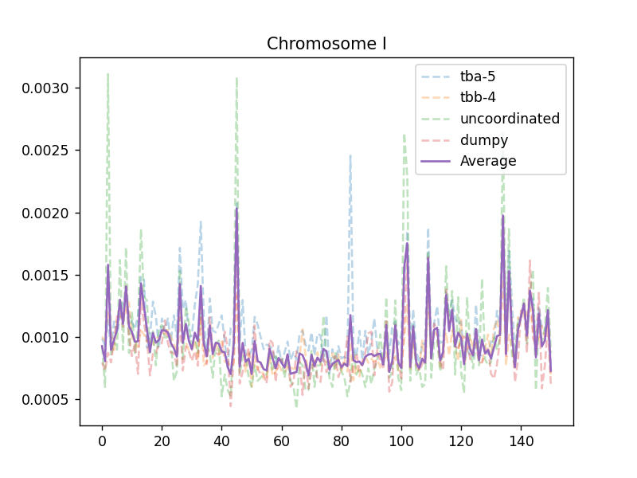
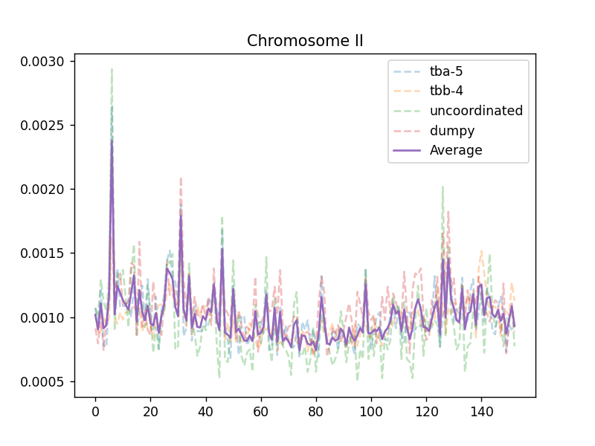
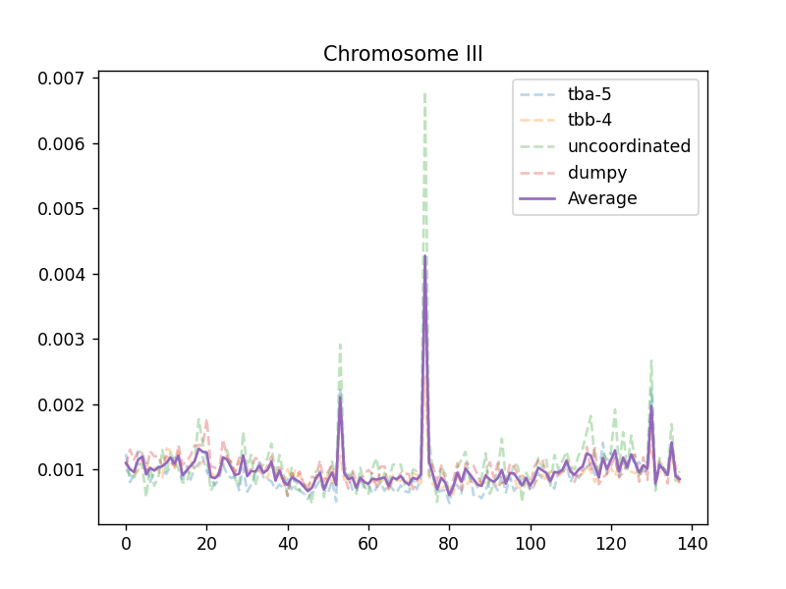
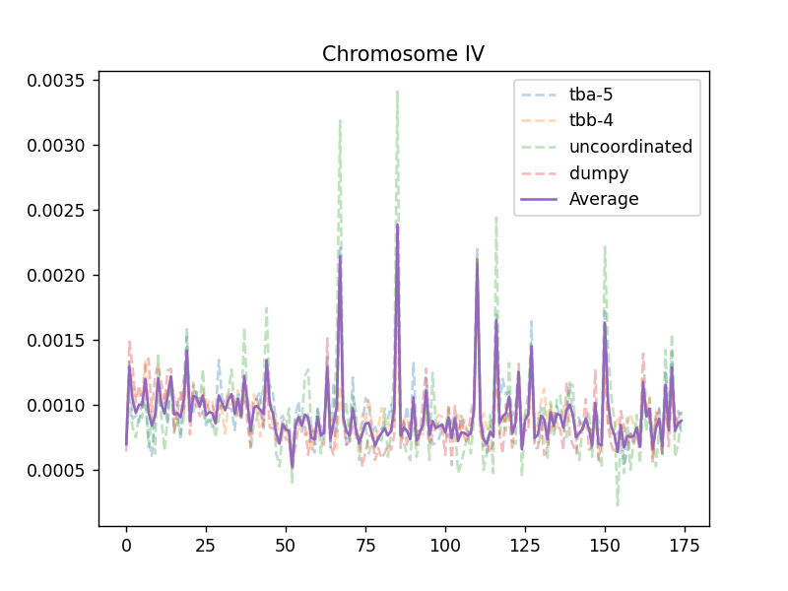
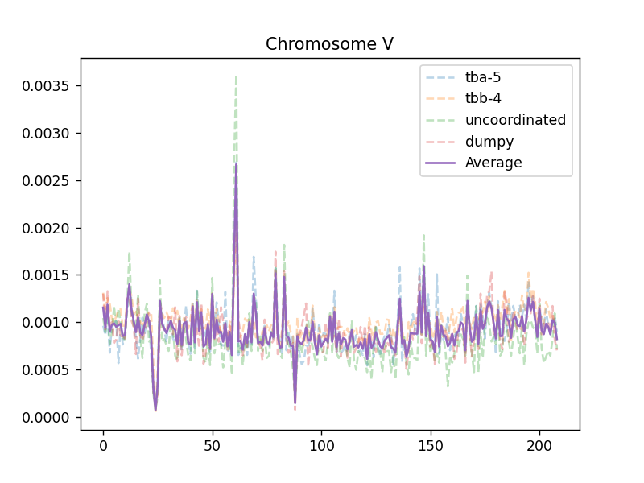
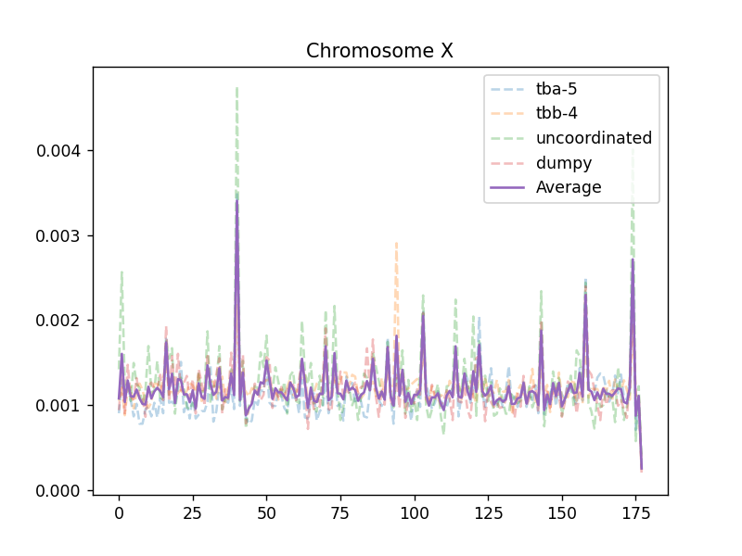

Slide 37
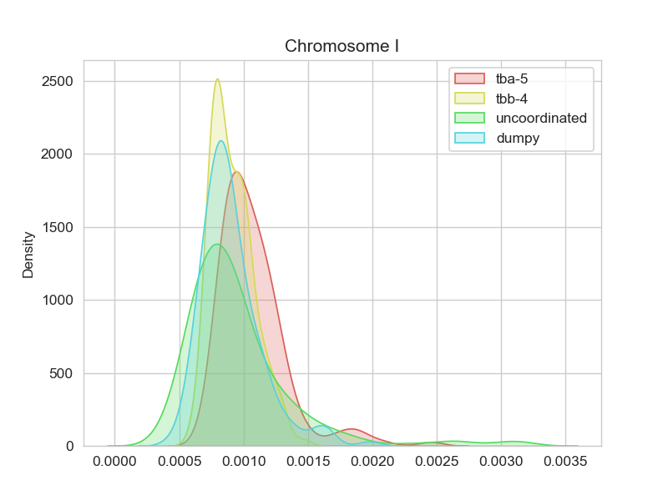






Slide 38


Std.

Slide 39


High frequency outlier
（≥Mean + std）
Low frequency outlier
（≤Mean - std）

Slide 40


High frequency outlier
（≥Mean + 2*std）
Low frequency outlier
（≤Mean - 2*std）

Slide 41

thriple-base in high freq region

Slide 42

thriple-base in low freq region

Slide 43

high-low

Slide 44

High-std

Slide 45

Low-std
Percentage of A-T,G-C

Slide 46




A/T percentage
dumpy
P(MUT)
lg(P(MUT))
A/T percentage
2
P(A/T) – 0.6
(P(A/T) – 0.6)

Slide 47


P=3.150339e-25
Spearman = -0.2286
y = -21.59x-7.587
P(MUT)
lg(P(MUT))
P(A/T) – 0.6
(P(A/T) – 0.6)

Slide 48





dumpy
‘A/T’
Poly A
Poly C
Poly A/C
exon

Slide 49


Spearman = 0.2342
p=0.2941
Spearman = 0.3434
p=1.1249e-56
mut
Poly A
Poly C

Slide 50

Spearman = -0.2155
p=1.614e-22
How to explain the hotspot/cold spot?
exon

Slide 51

Rate = mut(triple)/count(triple)

Slide 52



…ATGCGAATTGCCACT…
Code1
‘ATG’
Code2
‘TGC’
Code3
‘GCG’
Mutation rate:
r$\left[code\right]=\frac{mut\left[code\right](all genome)}{n[code](all genome)}$
$$std=\sqrt{\frac{\sum_{i=1}^{64}{{(n_{i}[code]−p_{i}[code])}^{2}}}{n}}$$
Predicted mutation:
$$p\left[code\right]=r\left[code\right]∗n[code](300,000bp)$$
Tbb-4
std
13.09

Slide 53



dumpy
dumpy
std
Tbb-4
std
tbb-4
dumpy

Slide 54




Only focus on ‘C’ and ‘G’ mutation
dumpy
Tbb-4
12.9
High variation due to genomic repair?
|Dumpy std – tbb-4 std|
G/C only

Slide 55




How many base should I use to evaluate the mutation frequency of the central base?
+ chain: exp:
A:32371810 0.32279
T:32373344 0.32280
C:17782105 0.17731
G:17759142 0.17708
Chi-square test for
each position

Slide 56

0.1769 7.7156 22.8757 28.4276 58.2035 16.9557 5.8219 2.6879
0.9812 0.0522 4.28e-5 2.95e-6 1.42e-12 7.21e-5 0.1206 0.4422
-2/-1/0/1/2 is the best pattern

Slide 57

Why triple codon?
5 –base combination also in a symmetric pattern

Slide 58


Remaining the same in different screening data
OSM-3
tbb-4
dumpy
TTN-1

Slide 59



ttn-1

Slide 60



tbb-4

Slide 61



dig-1

Slide 62



Cla-1

Slide 63



tba-5

Slide 64


How accurate can this model predict EMS mutagenesis
TBB-4 data
(Count-predicted)/predicted
accuracy
Gene length
±0.5：3173/4464 = 71.08%
±0.3：1943/4464 = 43.53%

Slide 65


dumpy data
±0.5：726/1147 = 63.30%
±0.3：473/1147 = 41.2%

Slide 66


P-val binorminal distribution padj:BH tbb-4 data
padj
Gene length
<0.05：1183/26239 = 4.51%
<0.01：559/26239 = 2.13%
<0.001：271/26239 = 1.03%

Slide 67


P-val binorminal distribution padj:BH dumpy data
padj
Gene length
<0.05：113/20160 = 0.5%

Slide 68

probability
length

Slide 69


Silent region
Chrom V:
X10^6
Consist with the TF binding activity

Slide 70


Chrom:X

Slide 71



PolII Early embryo stage
Lin-54 L3 stage
Lin-37 LTemb stage
Dumpy real data

Slide 72


Slide 73


Slide 74


Real data(dumpy)
P[code]
Pol II binding activity
a(experiment)*f(P[code])*f(Chromasome structure)*something else?

Slide 75
Machine learning
1.Data collection and preprocess for small scale test:
1.How to define the question? -- Smooth the mutation data
1. Creat a norm curve as a seed
Mean = 0.5
Std = 0.15
n = mean gap of the chromosome
Mixed gaussian model-like

Slide 76


How to define ‘High frequency region’ or ‘Silent region’

Slide 77
Feature
1.Histone modification
H3 144 L3 stage
H3K27ac early embryo
H3K27me early embryo
H3K27me L3
H3K36me3 late embryo
H3K4me3 late embryo
H3K79me mixed embryo
H4dam L3
2.Centrisome binding
HCP3 early embryo
HCP3 late embryo
3.Chromatin silencing
His-72 TILLING
Hpl-2 L3
4.Nuclear envelope interaction
LEM2 mixed embryo
5.TF binding activity
RNA Pol II average stage
Unc-39 embryo
Unc-62 embryo
Unc-62 young adult
W03F9.2
W03G10AR18
Ztf-11 embryo
6. Base bias
Smooth with a 100 base frame

Slide 78

Preprocessing of features:

Slide 79
Preprocess
1
100
150
1
100
………
-25
25
Average = 0
Average = 0.01
150
………
1
100
150

Slide 80


After smooth

Slide 81

2.Choose model
LASSO
1.Regression model
2.Classification model
Linea regression
Rigid
ACCURACY<0.2%
Elastic net
Y(mutation factor) = w1x1 + w2x2 + w3x3 + ….+ wnxn
With different restriction
Decision tree model
For example:
TF binding activity is the strongest factor
Only when the region can bind with TF
It can be accessed by other factors
To reduce the information entropy at first, I set the
Value of input -2 instead of 0 to make it easier to
be seen as a key factor
Plan B

Slide 82
Random Forest:
Randomly use different part of the input data (different feature and different sample) to build different trees,
Take the average output as the final output.
Use 80% as training set and 20% as test set separately to avoid over fitting.

Slide 83


Slide 84



Slide 85







Choose 64 estimator

Slide 86






generalization ability
Trainning set:0.2
0.3
0.35
0.4
0.45
0.5

Slide 87


Estimator = 30
Estimator = 8
predict
predict
data
data

Slide 88













Slide 89










Slide 90
The tree might be like:
HIS-27(high freq)
H3K4me3(low freq)
Important feature
W03F9.2(mid)
H3K27(low freq)
LEM2,unc-39,unc-62,Y39G10AR18,HCP3,H4Dam
Unused histone,TF data
Code
Not-so-important feature

Slide 91






Slide 92






Slide 93













Slide 94












Slide 95







Slide 96



Separate model
Whole genome model

Slide 97



Separate model
Whole genome model

Slide 98


Slide 99


Some outliers have a bad effect on this model: tbb-4

Slide 100
correct
Plan to remove outliers
result
1.Training – Predicting
2.Remove data which is not well predicted(0.1%)
3.Return to step 1
OR
Outlier because of screening selection
Remove them before training (Grubbs etc.)
400*600*2 = 480000 bases

Slide 101


1st time de-outliers 91988000:91991000,,,,67750000:67830000

Slide 102


Slide 103
1
K-1
test
train
train
test
train
Evaluate each test
and calculate average score
train
test
train
train
test

Slide 104


Ttn-1 mutation predicted without ttn-1 in training set
20-fold test

Slide 105


Slide 106

20-fold test 500 average

Slide 107

Silented Chrom V

Slide 108

Tbb-4 mutation factor
Dpy mutation factor

Slide 109
Million mutation project Data
VC20* are EMS mutated (737 strains)
265169 SNPs in total
Some results differ from Ou Lab screening forced me to look back on these datas

Slide 110



dumpy screening ttn-1 76
Tbb-4 screening ttn-1
161
mmp
210

Slide 111




Mmp data

Slide 112




exp

Slide 113
Chi-square
****
****
****
*
**
****
****
****
****
****

Slide 114
New plan 1
1. The mistake that continuous data cannot be simply randomly divided to test and train datasets.
Using cross value test
Tree Numbers versus Tree depth

Slide 115
New plan 2
No smooth but input 0,1,2
0,0,0,0,1,2,1,1,1,2,1,0,0,0
average

Slide 116



Slide 117



Slide 118
9434452 9436893

Slide 119


7004 genes in chrom V
Mmp data
Predicted mutation factor

Slide 120


Mmp chi2

Slide 121



Slide 122


Slide 123


Average_mutation
predicted

Slide 124


Spearman = 0.23
p=1.774e-25
Spearman = 0.23
p=1.774e-25
Really happened
Really happened
PolII ChIP-seq
Predicted

Slide 125

?
Mut freq in intron is lower
Tbb : total mutation snp: 184594
intron variant: 7225
total intron length: 13780055
predict to have 25196.8 mutations
so why?
Chrom I kde plot

Slide 126
Red outliers
1.5 * IQR
0.00306919244550399
blue
0.0004136708362060475
0.00016339201829990605
Middle:7564460, low: 3760398, high: 3747572

Slide 127


Slide 128


Slide 129



5bp C/G only
7bp
7bp C/G only

Slide 130




C
G
A
T

Slide 131


Slide 132

Tbb-data with tbb

Slide 136
Estimator = 8
Estimator = 30
predict
predict
data
data

Slide 137


Slide 138





-code
-nuclear envelope
interaction
-Centrosome
-His-27
-His-27(only)
High freq formation need at least one set of these data

Slide 139


- All TF binding data

Slide 140
EMS screening
Osm-3 p802
G444E
Test cross and Mapping
Whole Genome Sequencing
Phenotype II
dye-filling
Phenotype I
Compare with wildtype
And Mapping samples
~300 Single nucleotide variation due to EMS
Can focus on about ¼ length of a Chromosome

Slide 141
SNP pool of
osm-3(sa125) suppressors
Unc-89
Nekl-4
ttn-1
Gene x

Slide 142
Mutation frequency per 300000 base
tbb-4 (438)
tba-5 (195)
dumpy (256)
unc (120)

Slide 143

EMS mutagenesis

Slide 144
How many base should I use to evaluate the mutation frequency of the central base?
+ chain: exp:
A:32371810 0.32279
T:32373344 0.32280
C:17782105 0.17731
G:17759142 0.17708
Chi-square test for
each position

Slide 145
0.1769 7.7156 22.8757 28.4276 58.2035 16.9557 5.8219 2.6879
0.9812 0.0522 4.28e-5 2.95e-6 1.42e-12 7.21e-5 0.1206 0.4422
-2/-1/0/1/2 is the best pattern

Slide 146
Why triple codon?
5 –base combination also in a symmetric pattern

Slide 147
ttn-1
184594:18 per 10kb

Slide 148
tbb-4

Slide 149
dig-1

Slide 150
Cla-1

Slide 151
tba-5

Slide 152
Silent region
Chrom V:
X10^6
Consist with the TF binding activity

Slide 153
Chrom:X

Slide 156
PolII Early embryo stage
Lin-54 L3 stage
Lin-37 LTemb stage
Dumpy real data

Slide 157
Real data(dumpy)
P[code]
Pol II binding activity
a(experiment)*f(P[code])*f(Chromasome structure)*something else?

Slide 158
How to define ‘High frequency region’ or ‘Silent region’

Slide 159
Feature
1.Histone modification
H3 144 L3 stage
H3K27ac early embryo
H3K27me early embryo
H3K27me L3
H3K36me3 late embryo
H3K4me3 late embryo
H3K79me mixed embryo
H4dam L3
2.Centrisome binding
HCP3 early embryo
HCP3 late embryo
3.Chromatin silencing
His-72 TILLING
Hpl-2 L3
4.Nuclear envelope interaction
LEM2 mixed embryo
5.TF binding activity
RNA Pol II average stage
Unc-39 embryo
Unc-62 embryo
Unc-62 young adult
W03F9.2
W03G10AR18
Ztf-11 embryo
6. Base bias
Smooth with a 100 base frame

Slide 160
Preprocessing of features:

Slide 161
Preprocess
1
100
150
1
100
………
-25
25
Average = 0
Average = 0.01
150
………
1
100
150

Slide 162
After smooth

Slide 163
2.Choose model
LASSO
1.Regression model
2.Classification model
Linea regression
Rigid
R2<0.002
Elastic net
Y(mutation factor) = w1x1 + w2x2 + w3x3 + ….+ wnxn
With different restriction
Decision tree model
For example:
TF binding activity is the strongest factor
Only when the region can bind with TF
It can be accessed by other factors
To reduce the information entropy at first, I set the
Value of input -2 instead of 0 to make it easier to
be seen as a key factor
Plan B

Slide 164
Random Forest:
Randomly use different part of the input data (different feature and different sample) to build different trees,
Take the average output as the final output.
Use 80% as training set and 20% as test set separately to avoid over fitting.

Slide 165
Choose 64 estimator

Slide 166
generalization ability
Trainning set:0.2
0.3
0.35
0.4
0.45
0.5

Slide 169
The tree might be like:
HIS-27(high freq)
H3K4me3(low freq)
Important feature
W03F9.2(mid)
H3K27(low freq)
LEM2,unc-39,unc-62,Y39G10AR18,HCP3,H4Dam
Unused histone,TF data
Code
Not-so-important feature

Slide 175
Separate model
Whole genome model

Slide 176
Separate model
Whole genome model

Slide 178
Some outliers have a bad effect on this model: tbb-4

Slide 179
correct
Plan to remove outliers
result
1.Training – Predicting
2.Remove data which is not well predicted(0.1%)
3.Return to step 1
OR
Outlier because of screening selection
Remove them before training (Grubbs etc.)
400*600*2 = 480000 bases

Slide 180
1st time de-outliers 91988000:91991000,,,,67750000:67830000

Slide 182
1
K-1
test
train
train
test
train
Evaluate each test
and calculate average score
train
test
train
train
test

Slide 183
Ttn-1 mutation predicted without ttn-1 in training set
20-fold test

Slide 185
20-fold test 500 average

Slide 186
Silented Chrom V

Slide 187
Problems：
How to avoid overfitting
How to remove outliers

Slide 188
Million mutation project Data
VC20* are EMS mutated (737 strains)
265169 SNPs in total
Some results differ from Ou Lab screening forced me to look back on these datas

Slide 189
dumpy screening ttn-1 76
Tbb-4 screening ttn-1
161
mmp
210

Slide 190
Mmp data

Slide 191
exp

Slide 192
Chi-square
*
**
****
****
****
****
****
****
****
****

Slide 193
Problem 2
No smooth but input 0,1,2
0,0,0,0,1,2,1,1,1,2,1,0,0,0
average

Slide 195
Ttn-1 in Tbb-4 vs ttn-1 in mmp

Slide 196


Slide 197

Tbb-4 model by seq
Tbb-4 model trained via tbb data

Slide 198
7004 genes in chrom V
SNP number
Mutation expect (n*p)

Slide 199


Almost all genes are well predicted in this model
Tbb-4 model
mmp model
SNP number
Mutation expect (n*p)
Mutation expect (n*p)

Slide 200


Genes predicted to have almost the same mutation frequency in different models.
Tbb-4
dumpy
mmp
mmp

Slide 201

Nekl-4
Osm-3 G444E screening
N = 94
Padj(-lg)
Nekl-3
F49E12.8
Fold Change (-log2)

Slide 202

tbb-4
Tbb-4 screening
N = 438
Total snp = 183323
Padj(-lg)
Y55F3C.17
Y69H2.21
Y69H2.25
tba-5
Fold Change (-log2)

Slide 203

Osm-3 G444k screening
N = 19
Nekl-4
Dyf-18
Padj(-lg)
H39E23.3
Y55F3C.17
Fold Change (-log2)

Slide 204

dpy-3
dpy-1
F40C5.2
Y69H2.21
dpy-6
dpy-8
Padj(-lg)
dpy-2
dpy-9
dpy-7
Y55F3C.17
F14F7.5
dpy-10
sre-21
dpy-13
dpy-17
mct-2
Fold Change (-log2)

Slide 205


Slide 206

abt-2
Million mutation project
N = 737
gcn-1
abts-3
Padj(-lg)
Fold Change (-log2)

Slide 207


Slide 208



Slide 209
Some important data
C/G : 0.354
Prediction >0.01(mean+2std): 5974484(0.059 of genome, 0.154 of C/G)
mutated : 78315 (0.2954)
MEAN: 0.0026
STD: 0.0038

Slide 210


Model I: predicting the EMS mutagenesis frequency
$$P_{mut}=α_{0}f(x)$$
genome
ATGGACCAATTA………AATTAGGCAATCCAGG
Pentabase bias
Histone modificcation
For prediction
All Features
……
…………
Mutation number
00100100000 …………00000100000010
Model II: predicting the EMS accessbility
$P=αf\left(x\right)∗P_{0}$
genome
ATGGACCAATTA………AATTAGGCAATCCAGG
Histone modificcation
……
Calculation
Of
Feature importance
Chromosome
Features
…………
$$\frac{n}{P_{0}}$$

Slide 211



Genome scanning evaluation: compare the prediction to actual data every 300000 bp.
Base bias
Model II
Model I

